Slide 1
REKINDLE THE FIRE
GETTING OTHERS
TO ASK YOU TO TELL THEM ABOUT JESUS!

Slide 2
What are the top five questions people are asking in their deep heart?

Slide 3
What is the meaning and purpose of life?
How can I have inner peace?
What is love?
How can I live with security?
What happens when I die?

Slide 4
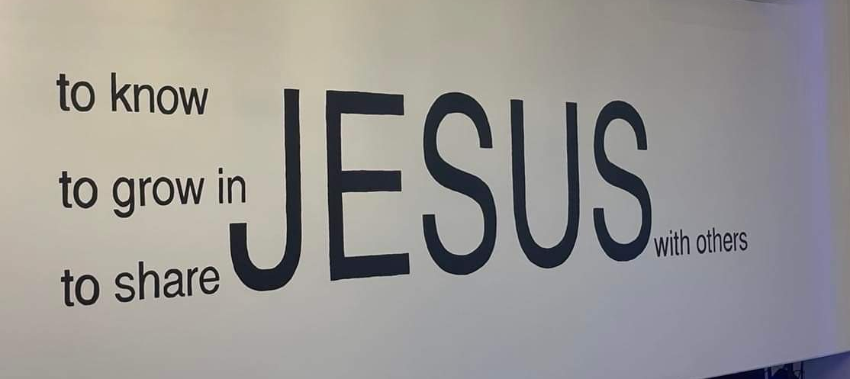
Guiding Principles
Jesus commands us to go, share the good
news and make disciples of all peoples.

Slide 5
The majority of witness training starts
with the presenter taking the initiative
with the person being witnessed to as a
receiver.
3. Most Christians are terrified of attempting
to share the Gospel.

Slide 6
Most witness training is unnatural, often
forced and does not take into account
the temperament of the presenter or the
needs of the listener.
Unbelievers truly want to find Jesus, even
though they don’t know it, since eternity
has already been planted in their hearts.
Ecclesiastes 3:11

Slide 7
6. Listening and asking questions has been
proven to be the most effective tools in
building personal relationships and
witnessing.
7. Christians do not need to answer every
spiritual question asked by the listener,
but rather need to be prepared to share
the Gospel of Jesus Christ when asked.

Slide 8
The presentation of the Gospel should be
biblical, short, concise and memorable.
9. Jesus’ command is not to merely get
“decisions’ but to “make disciples.’
10. Following up on new believers and
incorporating them into the church is
as important as presenting the Gospel
in the first place but few follow through.

Slide 9
Levels of Awareness
How aware are you of others?
Oblivious
Aware
Alert
Engaged
Spiritually Connected

Slide 10
St. Paul in I Cor. 9:19 For though I am free from all, I have made myself a servant to all, that I might win more of them. ²⁰ To the Jews I became as a Jew, in order to win Jews. To those under the law I became as one under the law (though not being myself under the law) that I might win those under the law. ²¹ To those outside the law I became as one outside the law (not being outside the law of God but under the law of Christ) that I might win those outside the law.

Slide 11
22 To the weak I became weak, to win the weak. I have become all things to all men so that by all possible means I might save some. 23 I do all this for the sake of the gospel, that I may share in its blessings.

Slide 12
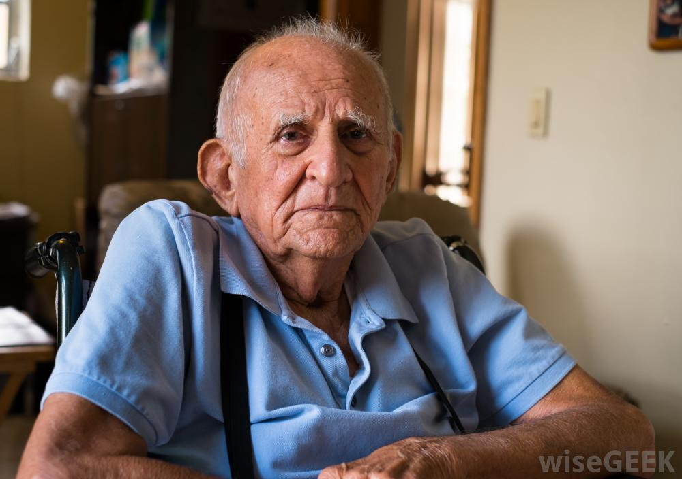
Survey of the Elderly
They would risk more.
They would reflect more on the meaning and purpose of life.
They would do more things that would live on after they were dead.
Notes:
–

Slide 13
The Purpose Driven Life
by Rich Warren.
25,000,000
copies sold!
Why?

Slide 14
Why Were We Created?
St. Paul gives us the answer.

Slide 15
2 Corinthians 5:17 Therefore, if anyone is in Christ, he is a new creation. The old has passed away; behold, the new has come. 18 All this is from God, who through Christ reconciled us to himself and gave us the ministry of reconciliation; 19 that is, in Christ God was reconciling the world to himself, not counting their trespasses against them, and entrusting to us the message of reconciliation.
20 Therefore, we are ambassadors for Christ, God making his appeal through us. We implore you on behalf of Christ, be reconciled to God.

Slide 16
2 Corinthians 5:17 Therefore, if anyone is in Christ, he is a new creation. The old has passed away; behold, the new has come. 18 All this is from God, who through Christ reconciled us to himself and gave us the ministry of reconciliation; 19 that is, in Christ God was reconciling the world to himself, not counting their trespasses against them, and entrusting to us the message of reconciliation.
20 Therefore, we are ambassadors for Christ, God making his appeal through us. We implore you on behalf of Christ, be reconciled to God.

Slide 17
2 Corinthians 5:17 Therefore, if anyone is in Christ, he is a new creation. The old has passed away; behold, the new has come. 18 All this is from God, who through Christ reconciled us to himself and gave us the ministry of reconciliation; 19 that is, in Christ God was reconciling the world to himself, not counting their trespasses against them, and entrusting to us the message of reconciliation.
20 Therefore, we are ambassadors for Christ, God making his appeal through us. We implore you on behalf of Christ, be reconciled to God.

Slide 18
Why Should We Witness
With Confidence?
Ecclesiastes 3:11a
He has made everything beautiful in its time. Also, he has put eternity into man's heart.

Slide 19
Why Should We Witness
With Confidence?
Ecclesiastes 3:11a
He has made everything beautiful in its time. Also, he has put eternity into man's heart.

Slide 20
WHAT CAN WE DEPEND ON?
All have it!
All need it!
Most cannot identify it.
Most often they misidentify it and substitute
something else.

Slide 21
Eternity in Our Hearts
Our goal is to help them identify their
greatest need.
Eternity in their hearts is the ‘God shaped
vacuum’ that St. Augustine talked about.

Slide 22
What Makes People Connect
with One Another?
Paying attention to the needs of others.
Active Listening.
Empathy.
Gentleness.
Availability.
Experiencing Joy.
Openness.
Understanding the cross-cultural realities!

Slide 23
FOUR REALITIES FOR EFFECTIVE WITNESSING
Striking up a conversation that focuses on their needs not your witness.
Building a Bridge (take time)
Seeking the guidance of the Holy Spirit.
4. Consistent follow-up.

Slide 24
Four Realities for Effective Witnessing Explained
Striking up a conversation that focuses on their needs not your witness.
How do you stay focused on their needs?

Slide 25
Four Realities for Effective Witnessing Explained
2. Building a Bridge (takes time)
What are the major steps in conversational bridge building?

Slide 26
Four Realities for Effective Witnessing Explained
3. Seeking the guidance of the
Holy Spirit.
How do you internally listen to the Holy Spirit?
How you externally listen to the Holy Spirit?

Slide 27
Four Realities for Effective Witnessing Explained
4. Consistent Follow-Up!
Identify five ways you can follow-up on a conversation and or profession of faith.

Slide 28
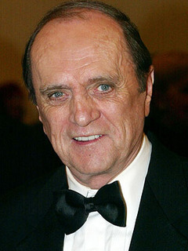
The Fundamentals of
Effective Listening.
•Don’t be a Bob Newhart!
“Reminds me of the time…..”

Slide 29
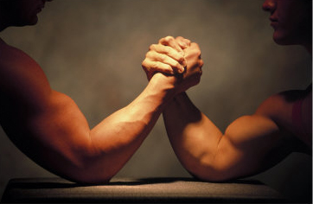
The Fundamentals of
Effective Listening.
Don’t take over the conversation!
It’s Not About You!

Slide 30
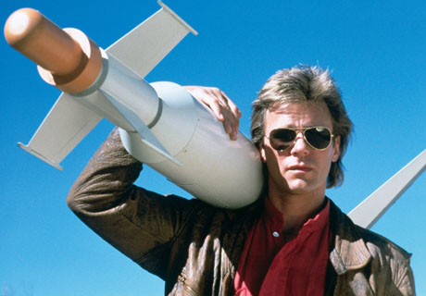
The Fundamentals of
Effective Listening.
Don’t Solve Their Problem.
It’s their issue. Permit them to talk about it.

Slide 31
The Fundamentals of
Effective Listening.
Listen to them.
Listen to the Holy Spirit.
When you listen you will truly hear!!!!!

Slide 32
The Fundamentals of
Effective Listening.
Listening Between the lines.
20

Slide 33
8/6/12
Effective Listening Contains
three Components.
Identifying and reflecting back the FEELINGS of the speaker.
Identifying and reflecting back the CONTENT of the speaker.
Identifying and listening to the HOLY SPIRIT while PRAYING under your breath.
20

Slide 34
8/6/12
Your Role in Effective Listening?
To listen closely and reflect back
both the feelings and the content of the speaker!

Slide 35
Turn to the person next to you.
Pick one story line from below but don’t tell the listener. One person picks a story and then hints at it without saying what it is.
The listener’s job is to figure out the problem through active listening (Reflecting Back Feelings and Content.)

Slide 36
•Your spouse and you don’t
communicate like you used to
and it is painful.
OR
•How you felt the first time you
were rejected.

Slide 37
•You’re disillusioned with life and
Christianity.
Or
•You feel that your parents
neglected you.

Slide 38
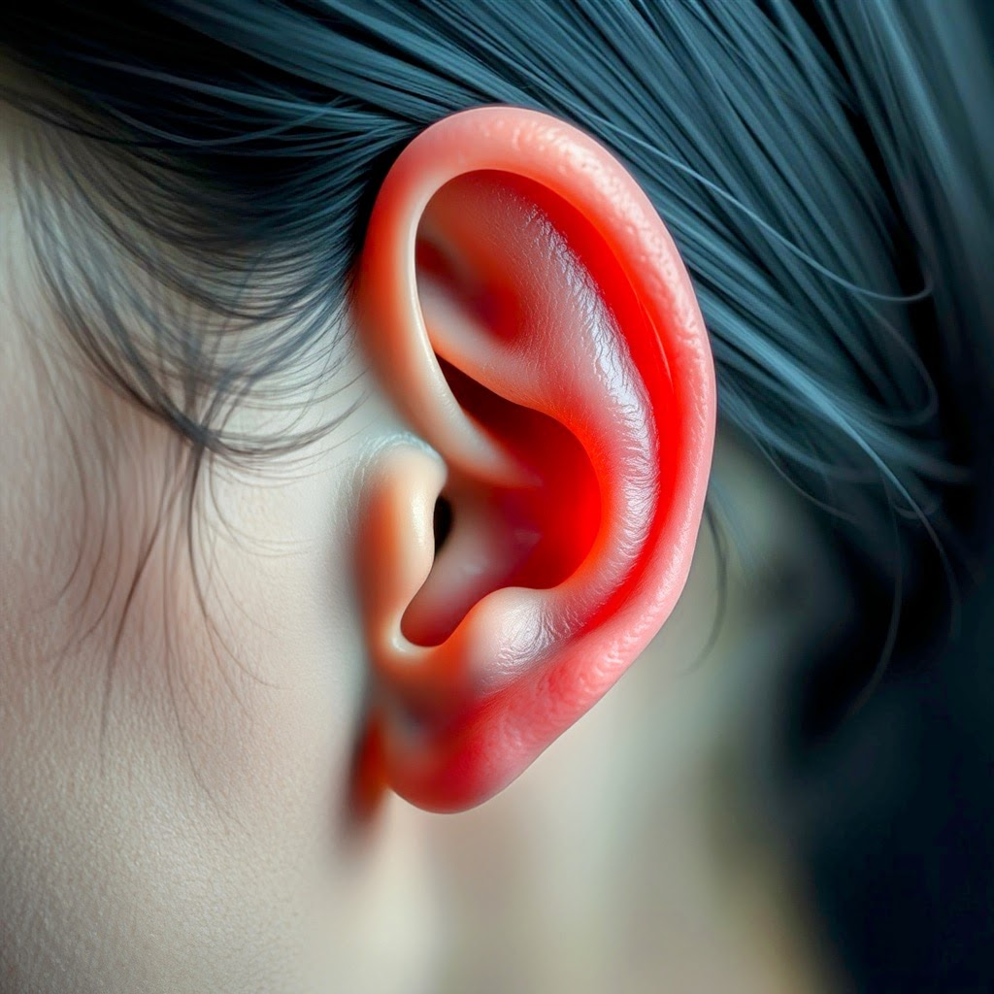
8/6/12
First Rule of Effective Witnessing is to Listen to Understand Them.

Slide 39
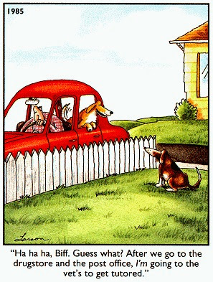
8/6/12

Slide 40
8/6/12
An effective listener is an investigator
looking for clues that reveal the truth.
20

Slide 41
8/6/12
Key Words or Phrases to Listen for.
•I’m sad
•I’m happy
•I’m hopeless
•Life is difficult
•I’m angry
•I feel so alone
•I want to die
•I want to give up
•No use going on
•What’s the point
•Why bother
•I give up
•I’m bitter
•I’m resentful
20

Slide 42
8/6/12
The Art of Asking Timely Questions
•It focuses on what the speaker has already said.
•It takes into account the feelings of the speaker.
•It takes into account the content of the speaker.
•It takes into account the unspoken behavior of
the speaker.
•It is a non-threatening means of giving the speaker
freedom to respond.
•It is open ended inviting more conversation.

Slide 43
8/6/12
Examples of timely questions:
“You said you feel that your life is hopeless and you want to give up. Would you like to find real hope?”
“You sound like you are ready to take a risk with your life to something meaningful. What would that look like?”
“You said you feel like dying. What happens after that?”

Slide 44
8/6/12
Timely Questions:
You are attempting to use their content and feelings to help them look deeper and more profoundly at their life and purpose!

Slide 45
8/6/12
LISTEN FOR TRANSITIONAL
STATEMENTS TO THE GOSPEL:
•I wish I knew my purpose.
•Why was I born?
•Why won’t God help me?
•I’m afraid to die.
•What’s the point?
•I don’t see a light at the end of the tunnel.

Slide 46
8/6/12
Your Response and Invitation
•Would you like an answer?
•Would you like to know for sure?
•I found the answer and I’d be glad to tell you
when you want to know.
FUNDAMENTAL TRUTH:
Until they want Jesus you
cannot give Him to them!

Slide 47
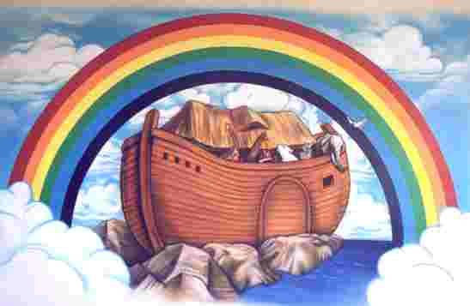
A.R.C.
8/6/12

Slide 48
8/6/12
A. R. C.
A = ALL of us have shame and guilt that we don’t know what to do with. This is called sin. It is crushing and painful.
(Romans 3:23)
4 All

Slide 49
8/6/12
A. R. C.
R=I have learned how to Release my shame and guilt by turning to Jesus and asking Him to forgive me and heal me.
(Romans 10:9)

Slide 50
8/6/12
A. R. C.
C=When I CONFESSED my shame and guilt to Jesus and asked Him to be my Savior and Lord I found inner peace, hope and purpose.
(Romans 10:13)
If U

Slide 51
8/6/12
Prayer of Commitment
A.B.C.D.
A-I Accept what the Bible says about my guilt, shame and sin seeking forgiveness.
B-I Believe that Jesus is the one and only Savior.
C-I Commit my life and eternity to Jesus.
D-I Decide today to be a life-long Disciple of Jesus Christ.

Slide 52
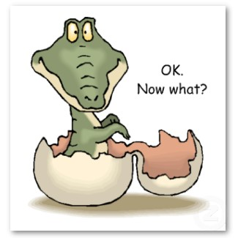
8/6/12

Slide 53
8/6/12
Prayer of Commitment
A.B.C.D.
This is Hugh and Mostly Ignored!
D-I Decide today to be a life-long Disciple of Jesus Christ.

Slide 54
8/6/12
Pray, Pray, Pray.
Connect,
Connect,
Connect.

Slide 55
8/6/12
Discipleship:
The Process!
Invite them each week to worship!
Keep asking if they don’t come right away.
If they do come introduce them as many believers as possible.

Slide 56
8/6/12
Discipleship:
The Process!
4. Make every attempt to meet with them once a week around a tool for study.
Use zoom, messenger, phone!

Slide 57
8/6/12
Discipleship:
The Process!
21 Day Challenge
(Free PDF download at www.toeternity.org)

Slide 58
8/6/12
Questions?

