Slide 1
Rescued and Redeemed: Colossians 1:13–14 and the New Exodus
June 14, 2023
Women’s Missionary Federation Day
AFLC Annual Conference

Slide 2
Colossians 1:13:
For He has rescued us from the dominion of darkness
and brought us into the
kingdom of the Son He loves,
¹⁴ in whom we have
redemption,
the forgiveness of sins.

Slide 3
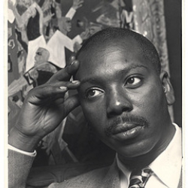
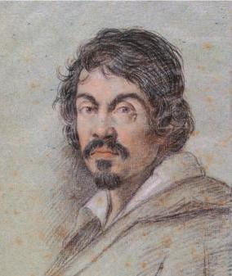
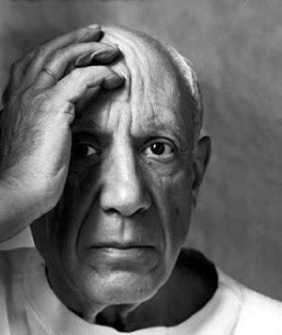
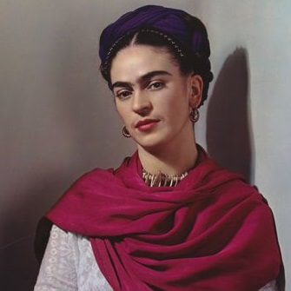
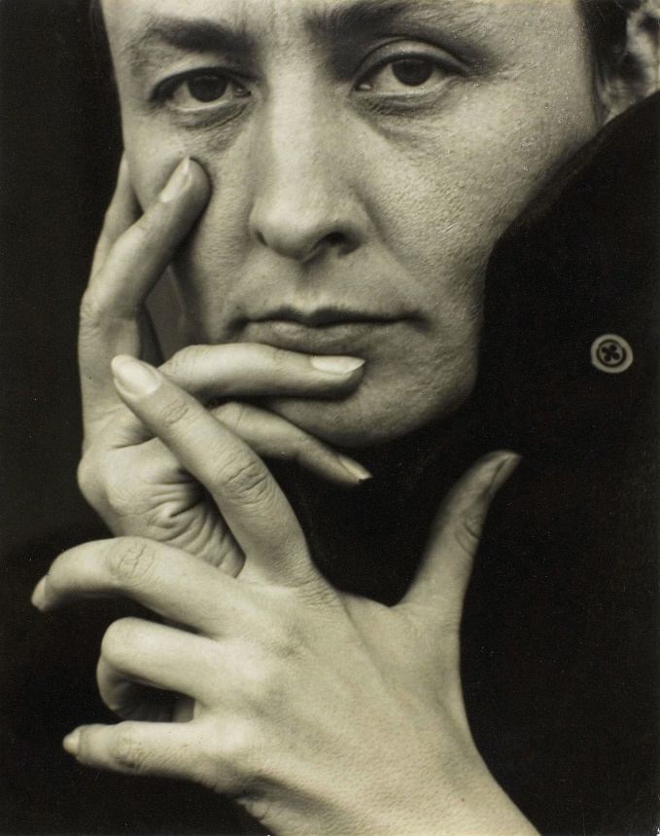
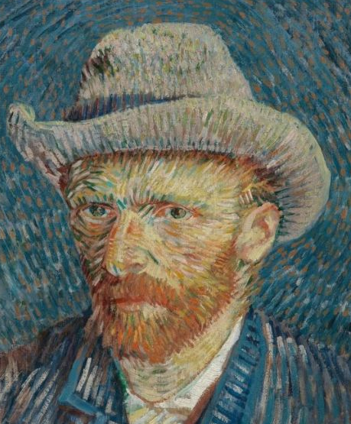
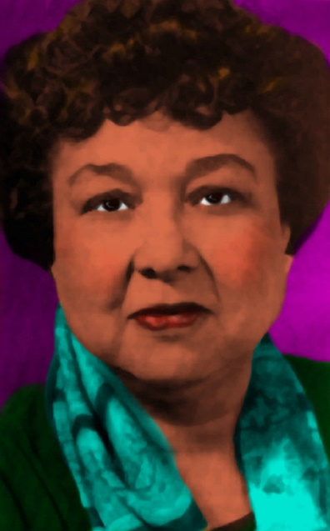
Greatest Artist in History?

Slide 4
“Best quilter in the world” for 3 straight years
Cynthia England
Houston, TX

Slide 5
“Piece and Quiet”
(voted one of the 20th Century’s best American quilts)

Slide 6
Nerstrand Big Woods State Park,
NE of Kenyon, MN

Slide 9
Frederick Carl Frieseke
“On the Beach”

Slide 13
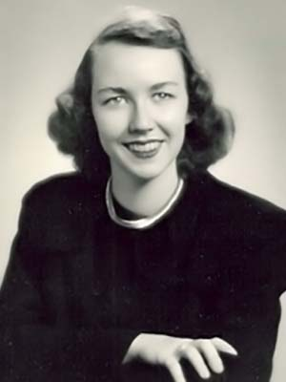
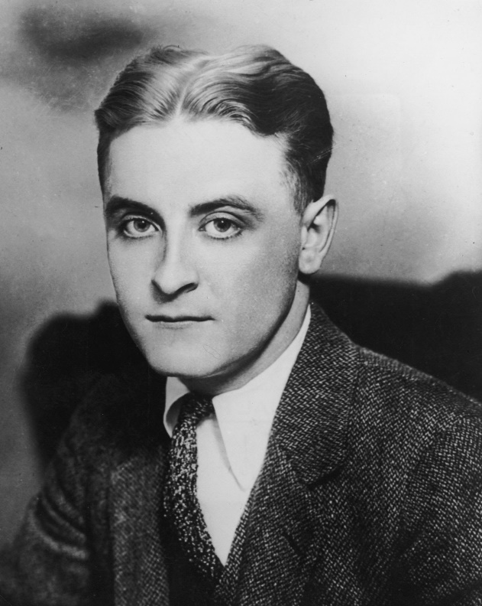
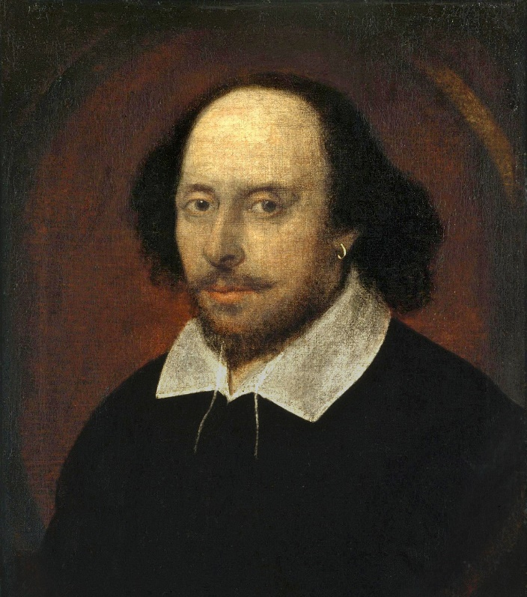
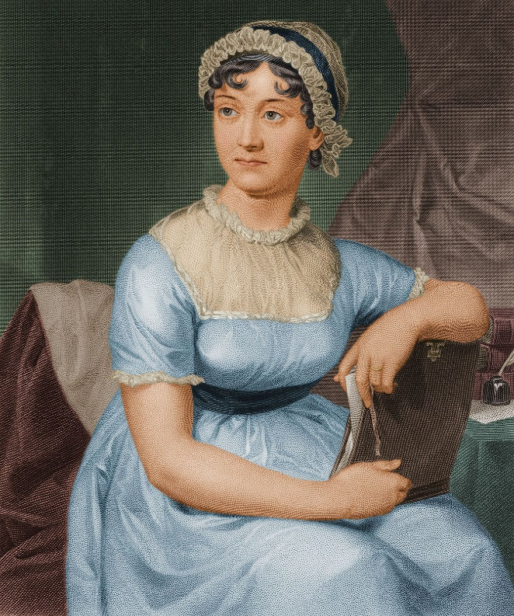
Greatest Artist in History?

Slide 14
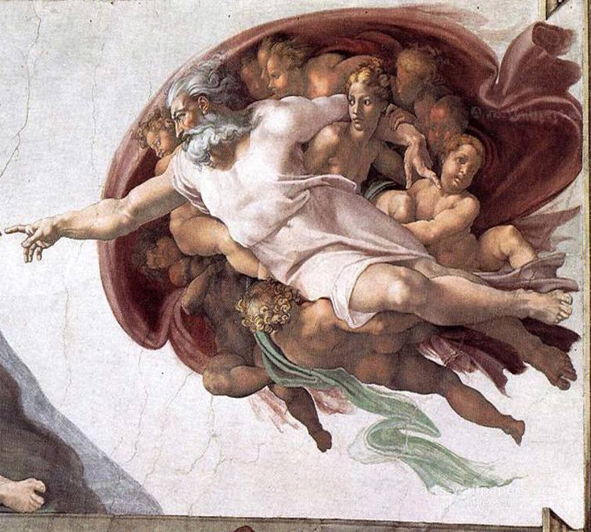

Slide 15
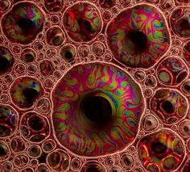

Slide 16
The Basic Concept
If God is the great artist of Creation,
then
we shouldn’t be surprised that He’s also
the great artist of History.
Salvation History,
Redemptive History

Slide 17
The Lord works in Patterns

Slide 18
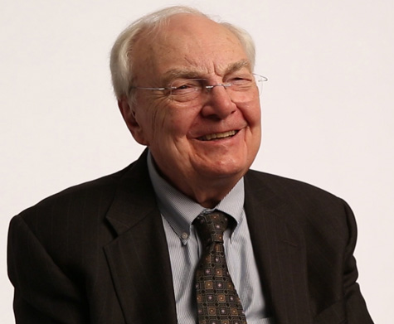
The LORD works in patterns
The fancy word for a pattern is a “type.”
“A type is a person, place, thing, or event by which God intends to picture something greater in the life of Christ and His Church.” (Bruce Waltke)
Typology presupposes that the LORD works in patterns in history.

Slide 19
The LORD’s main pattern for describing salvation in the Bible is…

Slide 20
The Exodus Pattern

Slide 21
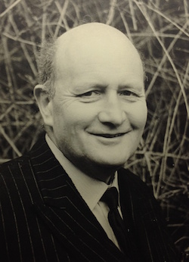
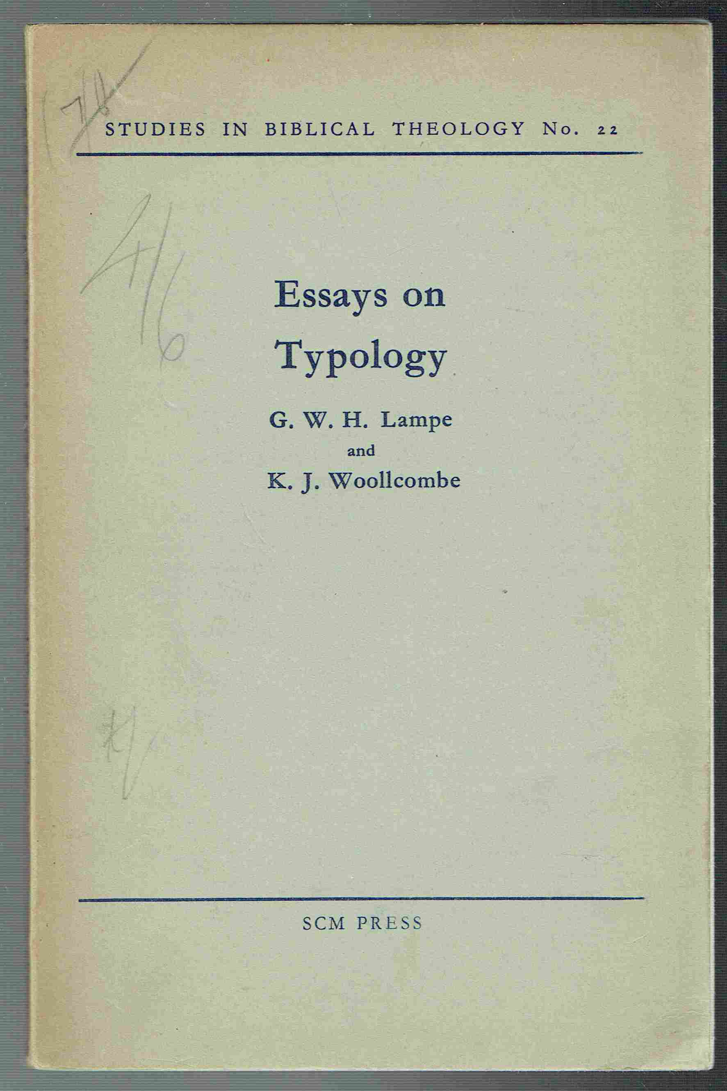
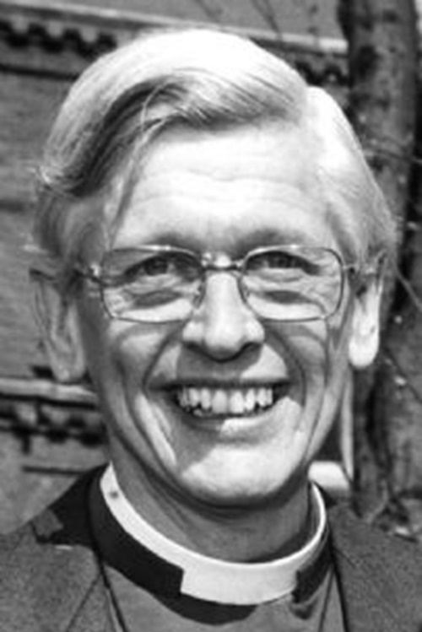
“Yahweh’s final deliverance of his people is consistently foreshown as a recapitulation of the events of the Exodus.”
(Lampe and Woollcombe 1957)

Slide 22
“It is commonly recognized that Isaiah 40-̶ 55 draws most heavily on the exodus as the archetypal act of YHWH’s deliverance”
(R. Reed Lessing).

Slide 23
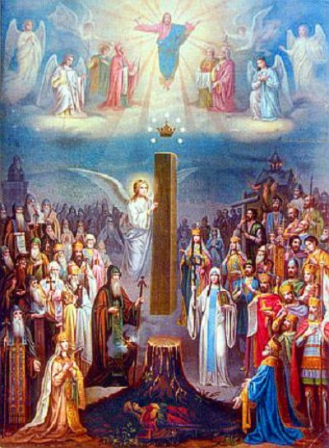
Isaiah 11
and the New Exodus
¹⁰ In that day the root of Jesse, who shall stand as a signal for the peoples—of him shall the nations inquire, and his resting place shall be glorious.
¹¹ In that day the LORD will extend his hand yet a second time to recover the remnant that remains of his people, from Assyria, from Egypt, from Pathros, from Cush, from Elam, from Shinar, from Hamath, and from the coastlands of the sea.

Slide 25
¹⁰ In that day the root of Jesse, who shall stand as a signal for the peoples—of him shall the nations inquire, and his resting place shall be glorious.
¹¹ In that day the LORD will extend his hand yet a second time to recover the remnant that remains of his people, from Assyria, from Egypt, from Pathros, from Cush, from Elam, from Shinar, from Hamath, and from the coastlands of the sea.

Slide 26
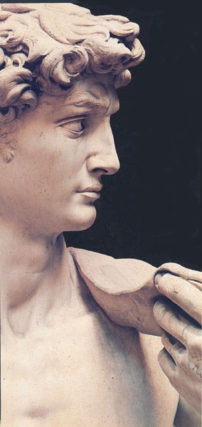
¹² He will raise a signal for the nations and will assemble the banished of Israel, and gather the dispersed of Judah from the four corners of the earth. ¹³ The jealousy of Ephraim shall depart, and those who harass Judah shall be cut off; Ephraim shall not be jealous of Judah, and Judah shall not harass Ephraim.
¹⁴ But they shall swoop down on the shoulder of the Philistines in the west, and together they shall plunder the people of the east. They shall put out their hand against Edom and Moab, and the Ammonites shall obey them.
2 Samuel 8

Slide 27
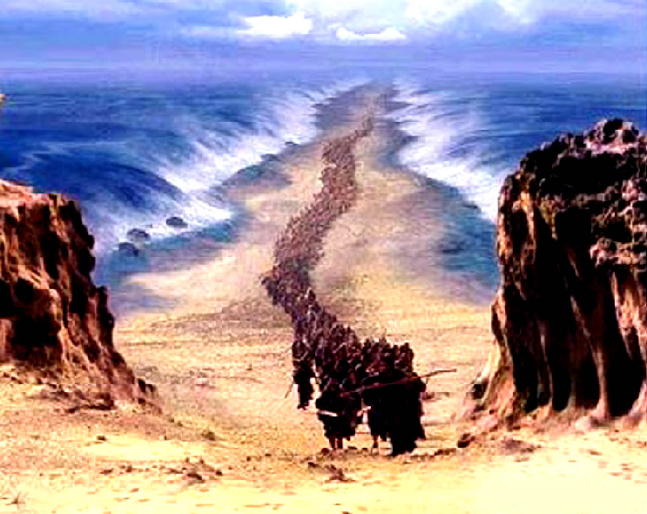
¹⁵ And the Lord will utterly destroy the tongue of the Sea of Egypt, and will wave his hand over the River with his scorching breath, and strike it into seven channels, and he will lead people across in sandals. ¹⁶ And there will be a highway from Assyria for the remnant that remains of his people, as there was for Israel when they came up from the land of Egypt.

Slide 28
Principle of Interpretation
OT
The LORD is using __________ language to describe __________ realities.
NT

Slide 29
Isaiah 43
and the New Exodus
¹⁶ Thus says the LORD, who makes a way in the sea, a path in the mighty waters,

Slide 30
¹⁶ who brings forth chariot and horse, army and warrior;
¹⁷ they lie down, they cannot rise,
they are extinguished, quenched like a wick.

Slide 31
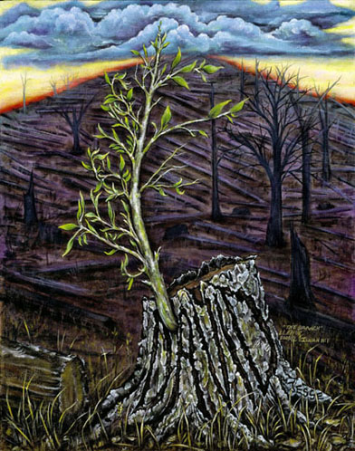
¹⁸ Remember not the former things,
nor consider the things of old.
¹⁹ Behold, I am doing a new thing,
now it springs forth, do you not perceive it?

Slide 32
¹⁹ I will make a way in the wilderness and rivers in the desert. ²⁰ The wild beasts will honor me, the jackals and the ostriches,
for I give water in the wilderness,
rivers in the desert,
to give drink to My chosen people,
²¹ the people whom I formed for Myself
that they might declare My praise.

Slide 33
OT
The LORD is using __________ language to describe __________ realities.
NT

Slide 34
The Exodus Pattern
The First Exodus
?
Out of Egypt

Slide 35
The First Exodus and the Song of the Sea’s End
Exodus 15:17:
You will bring them in and plant them on your own mountain,
the place, O LORD, for your dwelling,
the sanctuary, O Lord, that your hands
have established.
Out of Egypt
Mount Zion
How do we know?

Slide 36
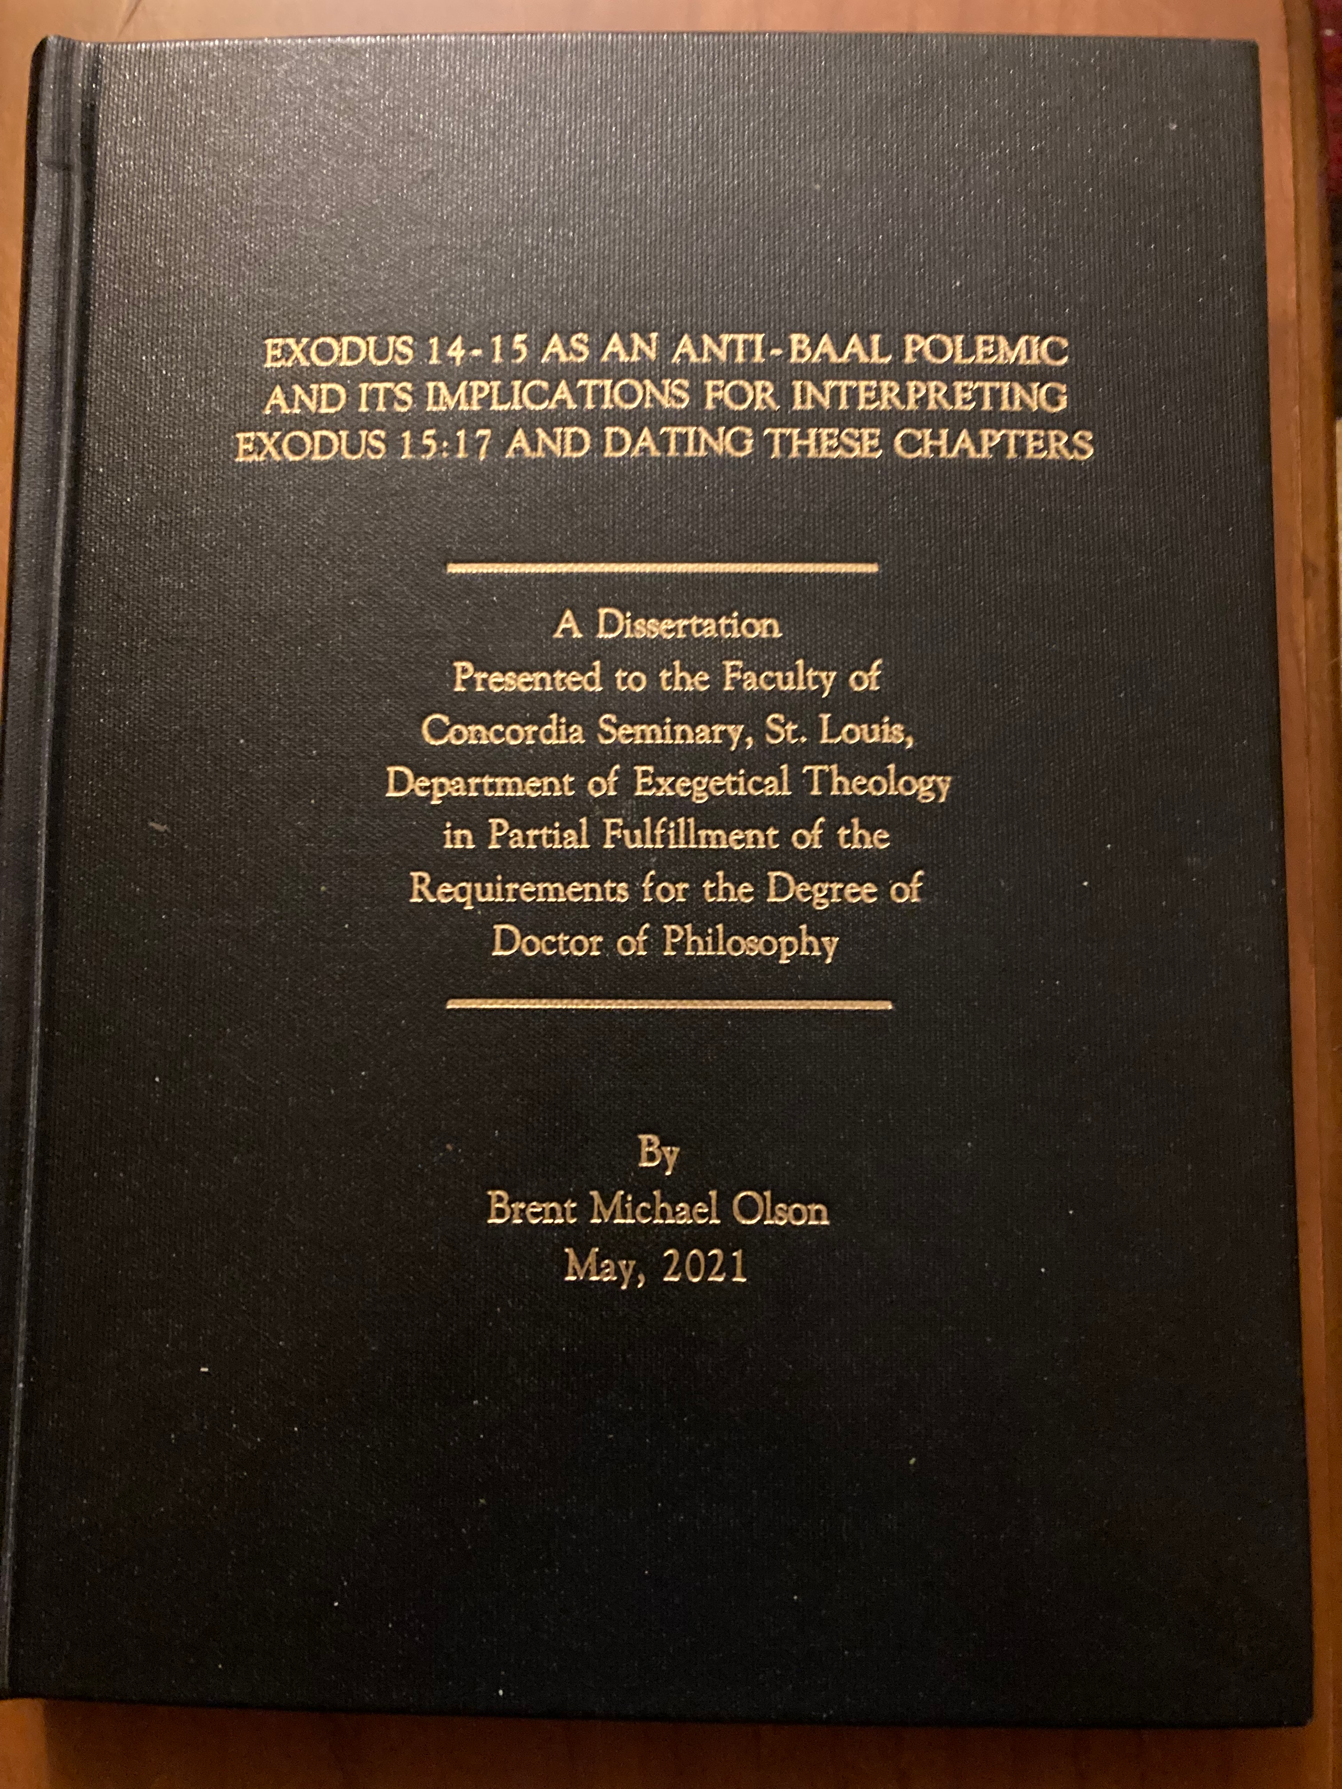
Picture of my dissertation

Slide 37
Isaiah 51 and the New Exodus
51:10 Was it not you who dried up the sea,
the waters of the great deep,
who made the depths of the sea a way
for the redeemed to pass over?

Slide 38
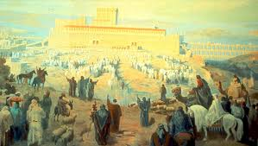
51:11 And the ransomed of the Lord shall return
and come to Zion with singing; everlasting joy shall be upon their heads;
they shall obtain gladness and joy, and sorrow and sighing shall flee away.

Slide 39
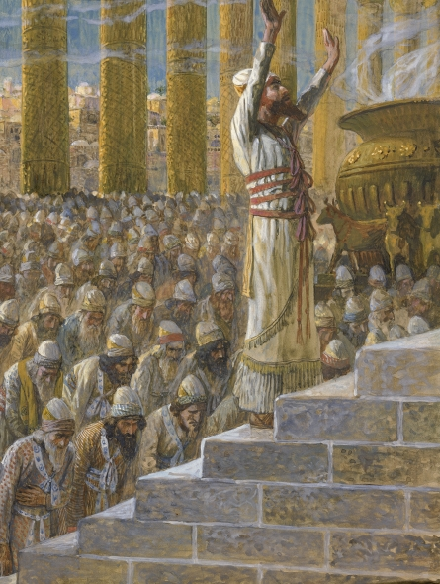
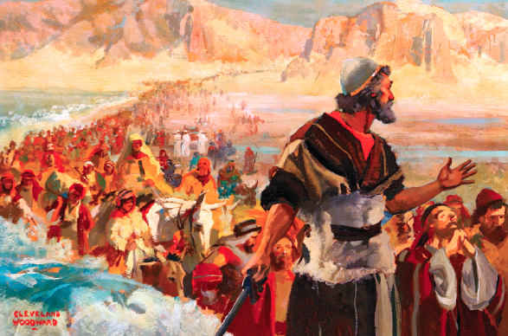
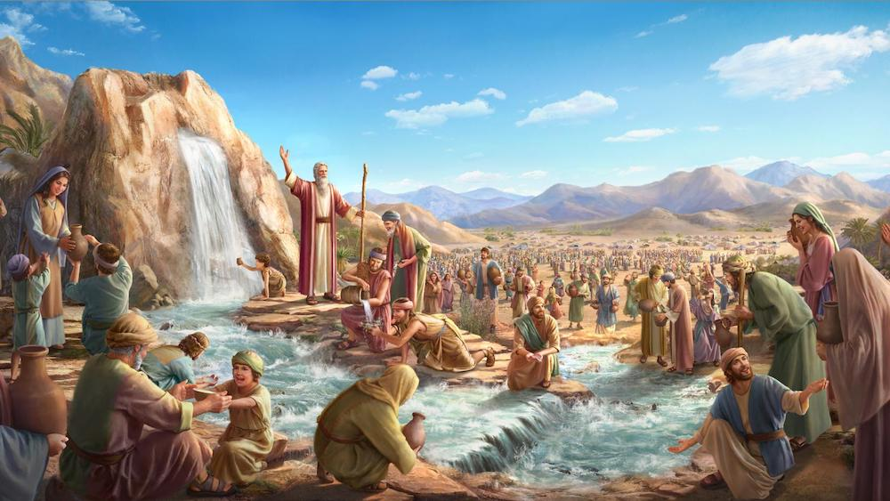
The Events of the First Exodus Pattern

Slide 40
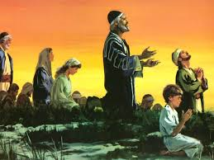
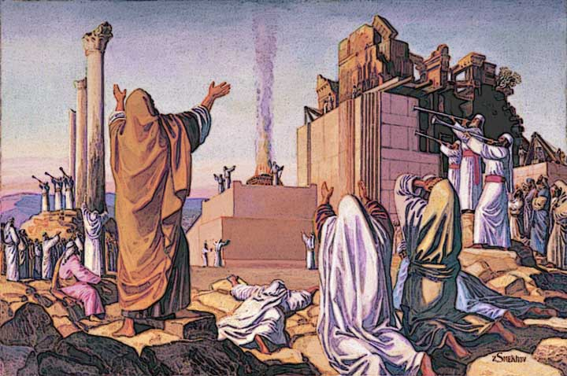
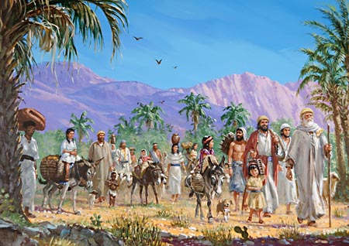
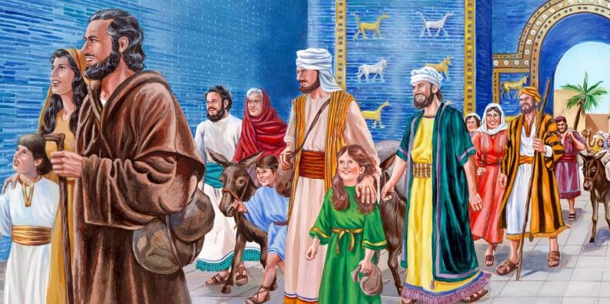
The Events of the Return from Babylonian Captivity

Slide 41
Ezra 9 ⁶ “O my God, I am ashamed and blush to lift my face to you, my God, for our iniquities have risen higher than our heads, and our guilt has mounted up to the heavens. ⁷ From the days of our fathers to this day we have been in great guilt. And for our iniquities we, our kings, and our priests have been given into the hand of the kings of the lands, to the sword, to captivity, to plundering, and to utter shame, as it is today. ⁸ But now for a brief moment favor has been shown by the Lord our God, to leave us a remnant and to give us a secure hold within his holy place, that our God may brighten our eyes and grant us a little reviving in our slavery. ⁹ For we are slaves. Yet our God has not forsaken us in our slavery, but has extended to us his steadfast love before the kings of Persia, to grant us some reviving to set up the house of our God, to repair its ruins, and to give us protection in Judea and Jerusalem.
ca. 458 BC

Slide 42
1st Century Messianic Expectation
The end of the First Exodus (from Egypt)—
David defeats the enemies of Yahweh’s people.
The son of David builds a Temple on Mount Zion in part to demonstrate Yahweh’s universal sovereignty.
The end of the New Exodus (from Assyro-Babylon)—
The people arrive back in Jerusalem under the auspices of Cyrus (538BC).
Zerubbabel & Joshua lead the building of an inferior Temple (520-516BC).
Israel’s Hope and Expectation—
A new David will come and complete this exodus by
defeating Israel’s enemies, welcoming His people into a restored Zion, and building (or rebuilding) the Temple.

Slide 43
“And those who went before and those who followed were shouting, ‘Hosanna! Blessed is he who comes in the name of the Lord! Blessed is the coming kingdom of our father David! Hosanna in the highest!’”
(Mark 11:9-10)
Hosanna! = Literally, Save (us), please!

Slide 44
King David
Conquering King
but also
Suffering Servant
(25/75 of David’s psalms are Laments)
Psalm 22: My God, my God, why have you forsaken me?

Slide 45
Luke 9: ²⁸ Now about eight days after these sayings he took with him Peter and John and James and went up on the mountain to pray. ²⁹ And as he was praying, the appearance of his face was altered, and his clothing became dazzling white. ³⁰ And behold, two men were talking with him, Moses and Elijah, ³¹ who appeared in glory and spoke of his which he was about to accomplish at Jerusalem.
departure
[ἔξοδος],

Slide 46
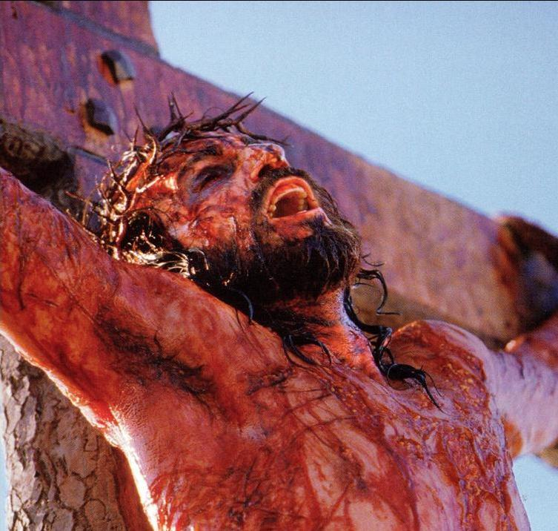
The New Exodus (Eschatological):
“The New and Greater David” defeats His people’s greatest enemies—
Sin, Death, and the Devil.
Isaiah 53

Slide 47
“The True and Better David” welcomes His people into the true Mount Zion, heavenly Jerusalem
Heb. 12:22–24
(Speaking to the believers in Jesus Christ, the Church)
²² But you have come to Mount Zion and to the city of the living God, the heavenly Jerusalem, … 24 and to Jesus, the mediator of a new covenant, and to the sprinkled blood that speaks a better word than the blood of Abel.

Slide 48
Great David’s “Greater Son” builds His Temple
“¹⁶ Do you not know that you are God's temple and that God's Spirit dwells in you?” (1 Cor. 3:16)

Slide 49
The Exodus Pattern
The First Exodus
Out of Egypt
Mt Zion
(2 Sam 7; I Kgs 8)
The New Exodus
i. Out of Babylon
Mt Zion
(Historical)
ii. Out of Satan’s Kingdom
(the kingdom of darkness)
Mt Zion
(Eschatological)
(the kingdom of light)

Slide 50
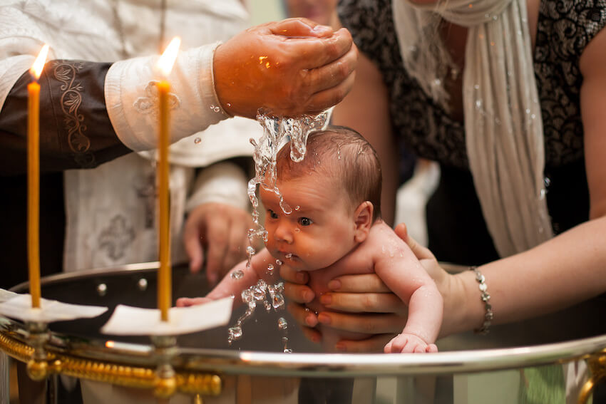
Colossians 1:13–14 describing the New Exodus:
¹³ For He has rescued us from the dominion of darkness and brought us into the kingdom of the Son He loves, ¹⁴ in whom we have redemption, the forgiveness of sins.

